Slide 1

The British Academy
University of Reading
Presenters:
Ken Emond, Head of Research Funding
Millie Hanson, Research Funding Officer
Jessica Meese, Deputy Head of International Programmes
Tara Okeke, Research Funding Assistant
Jack Payne-Cook, Research Funding Officer
Robert Rogers, Research Funding Officer
Lesley Talbot, Deputy Head of Research Funding
^{Date: 7th February 2023}

Slide 2



The British Academy
The British Academy is the UK’s national academy for the humanities and social sciences. We mobilise these disciplines to understand the world and shape a brighter future. ​
​
From artificial intelligence to climate change, from building prosperity to improving well-being – today’s complex challenges can only be resolved by deepening our insight into people, cultures and societies.​
​
We invest in researchers and projects across the UK and overseas, engage the public with fresh thinking and debates, and bring together scholars, government, business and civil society to influence policy for the benefit of everyone. ​

Slide 3



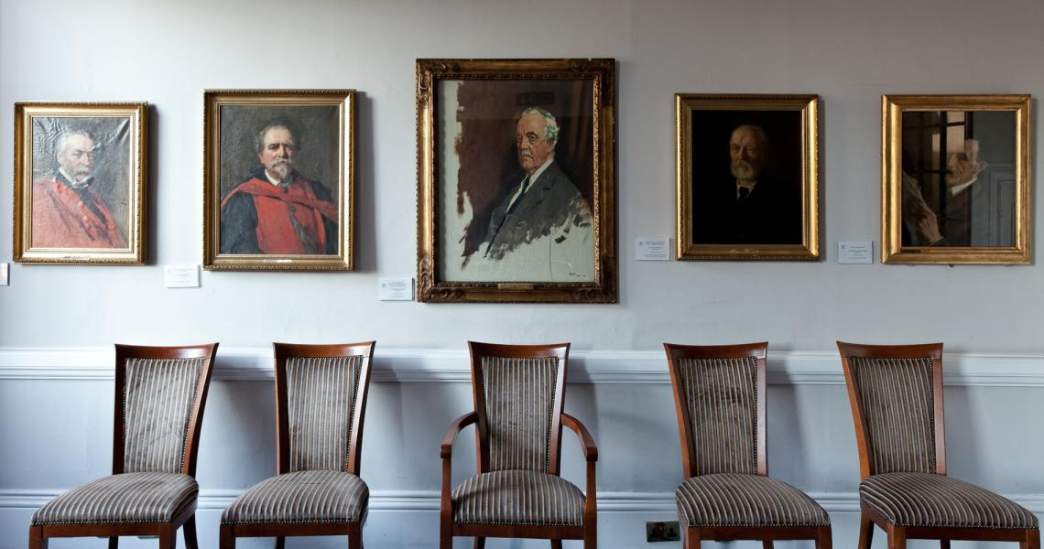
Our Academy
Received our Royal Charter from King Edward VII in 1902 and moved to 10-11 Carlton House Terrace in 1998
Purpose “To deepen understanding of people, societies and cultures, enabling everyone to learn, progress and prosper ”
The Academy inspires, supports and promotes outstanding achievement & global advances in H&SS
New Strategic Plan will be published during 2023 & strategic priority will continue to be:
To invest in the very best researchers and research

Slide 4
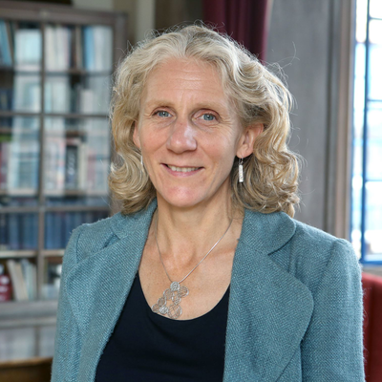

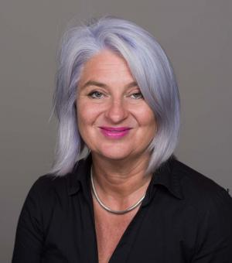
Our Fellowship
At the heart of the Academy is our Fellowship of over 1,400 leading national and international academics elected for their distinction in the humanities and social sciences.
The Fellows play an active role in the governance of the Academy and support its work through their involvement in events, awards, publications, and policy programmes.
Fellows join one or more of 21 Sections, which are in Humanities or Social Sciences Groups.
Beyond the Fellows, the Academy is part of an international network of scholars and partner institutions. Collectively, our community comprises the world’s leading thinkers in the fields of people, societies and cultures, and represents a major asset that the Academy is able to draw upon in the course of its work.

Slide 5



Our Activities
Our policy and research work spans issues across public policy, skills, education and research.
We provide a forum for examining issues at the heart of society and the economy eg 'The COVID Decade: understanding the long-term societal impacts of COVID-19' (evidence report) and 'Shaping the COVID decade: addressing the long-term societal impacts of COVID-19' (policy report).
Our current programmes include: the Skills Programme, Cohesive Societies, the Observatory, and Future of the Corporation
Our events showcase the latest research and thinking in a variety of subjects – from psychology to history and literature to politics. Events organised by the British International Research Institutes.
Our current events include 10 Minute Talks from Fellows of the Academy; Summer Showcase June 2023 ; Blogs and Podcasts; and regional lectures.

Slide 6


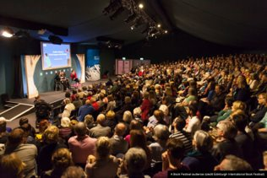
The Academy in Numbers
Over 1400 Fellows​
£40m awarded to researchers in the UK and overseas in the past year​
2,050 individual and project awards, including over 250 Early Career researchers​
Over 20 new UK and over 60 overseas partnerships created by the eight British International Research Institutes​
1.5 million visits to our website​
10,000 attendees at our online events in the last year​
Over 50,000 people have watched one of our weekly 10-minute talks and 15,000 have listened to our new podcasts
Over 1,500 attended last year’s Summer Showcase​ 16-18 June 2022
Over 70% of attendees at our online events in 2020-21 live outside of London
Future of the Corporation materials were downloaded over 10,000 times​
​
​

Slide 7

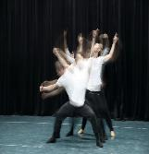

Our subject areas
Humanities
Social Sciences
In most schemes, there are no thematic priorities and the aim is to support research across the whole range of Social Sciences and Humanities subject areas.
We work closely with the other National Academies and Research Councils

Slide 8

Focus of research funding
Postdoctoral Research
Support at particular key career path moments
Largely response-mode funding schemes, but increasing opportunities for challenge-led grants
Individuals
International engagement
Most schemes do not ask for an impact statement, but we encourage communication of scholarly findings

Slide 9
Research and international schemes
BA/Leverhulme Small Research Grants (SRG)
Postdoctoral Fellowships (PDF)
BA/Wolfson Fellowships
APEX Awards
Newton International Fellowships (NIF)
Mid-Career Fellowships (MCF)
Senior Research Fellowships (SRF)
Innovation Fellowships
Talent Development Awards
International programmes and schemes

Slide 10

Postdoctoral Fellowships
Three-year Fellowship for early career researchers offering major career development opportunity
Currently offering up to 45 awards each year
Level of competition around 600-700 applications, giving success rate under 10%
Notes:
.

Slide 11
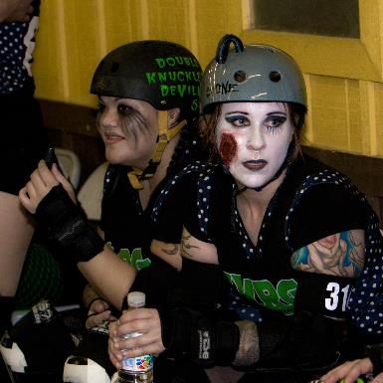
Postdoctoral Fellowships
Key characteristics
Career development
Focus on independent research
Experience of teaching, but limited requirements
Building on doctoral research, but focus on second research project
Based at UK university or IRO host

Slide 12
Postdoctoral Fellowships
Eligibility
Any EEA National
Anyone of any nationality with a UK doctorate
Date doctorate awarded (viva voce) usually within past 3 years – for next 2023-24 competition window extended from April 2021 to April 2024 and with funding for up to 55 awards
No current or former permanent academic post

Slide 13
Postdoctoral Fellowships
Process
Annual competition offered through two-stage selection process
Outline call for proposals closed 12 October 2022
Second stage opened January 2023
Final awards current round - confirmed in June 2023
Awards to be taken up between September and January following
Next outline call expected July 2023

Slide 14
Postdoctoral Fellowships
Average success rates over past 5 years

Slide 15

APEX Awards
Academies Partnership in Supporting Excellence in Cross-disciplinary research awards
Supports interdisciplinary awards unlikely to be funded through conventional funding programmes
Established researchers developing research in a new direction via collaboration with partners from other disciplines
Seed funding up to £100k over up to 24 months
Additional opportunity to bid for public engagement funding of further £10k
Main purpose of funding is teaching replacement for PI and/or Co-I
8 awards made in 2022 and 5 public engagement awards made to these researchers
Last call closed 2nd November 2022 – awards announced Summer 2023

Slide 16

British Academy Early Career Researcher Network
Aim is to establish a UK wide ECR Network that encompasses all Social Science and Humanities ECRs from a broad background that includes those that are BA funded and those that are not.
To provide ECRs with opportunities to enhance their learning and provide them with additional opportunities to gain government or industry links and vital experience that will enhance their careers whether it be inside or outside of academia.
To create an environment where ECRs strengthen their skills & networks to compete effectively in the job market.
Through this the BA wants to promote the use of SHAPE more widely - an opportunity to show the benefits of SHAPE disciplines regionally within industries outside of academia.
The Network is currently being piloted and is being structured by regions with a university-led Hub that coordinates local training and opportunities whilst the Academy leads on opportunities that are open to members across the Network.
University of Birmingham is the Hub for the Midlands, GW4 Alliance in the South West, and Stirling with Glasgow acting as co-hosts of the Hub in Scotland.
Over 2000 ECRs have joined in the first year. More information on the British Academy website.

Slide 17
BA/Wolfson Fellowships
Funded by Wolfson Foundation
3-year Fellowship to celebrate and empower early career researchers with time released from some academic duties
Awards designed to foster both research achievement and public engagement
Eligible applicants must be resident in UK, within 9 years of the award of doctorate and have a permanent or fixed term post covering length of award at university or IRO
2021-22 competition awarded 6 Fellowships - success rate under 5%
Call closed 7 December 2022 with 133 applications and awards will be announced in February 2023
Next competition will follow a similar timetable

Slide 18
Mid-Career Fellowships
6-12 months Fellowship for established researchers within 15 years of doctorate
Currently offering up to 43 awards each year funded by BEIS
Awards designed to foster both research achievement & public engagement
FEC basis with main funding cost being time of the award-holder
Limited research expenses
Two-stage selection process, call usually opens July and closes early September, this year on 7 September 2022
Awards announced in May to start following September through to January

Slide 19

Mid-Career Fellowships
Average success rates over past 5 years

Slide 20

Senior Research Fellowships
One-year Fellowship for established researchers needing time away from normal academic commitments
Funded by Leverhulme Trust, non-FEC basis
Offering 11 in 2022-23 including the Thank Offering to Britain Fellowship
Awards focused on bringing major piece of research to completion
Replacement teaching costs only, no research expenses
Annual competition – recent call closed 16 November and awards announced March 2023

Slide 21
Senior Research Fellowships
Average success rates over past 5 years

Slide 22

Innovation Fellowships
New scheme introduced 2021 funded by BEIS
Funding & support for UK university-based researcher to partner with organisations and business in the creative and cultural, public, private, & policy sectors to address challenges that require innovative approaches & solutions.
Supporting insights on a range of areas including local development, economic growth and community rebuilding and wellbeing.
Focus on knowledge translation and exchange.
Maximum of £120k payable primarily to cover salary or salary buy-out of the researcher plus well-justified direct project costs payable at a minimum of £10,000
Route A – researcher-led and Route B – policy led where the Academy has identified suitable partner, so far including FCDO, ONS, DLUHC
Call varies depending on partner, but expected autumn for Route A, decisions January
Up to 24 awards across both routes expected in 2023-24
Notes:
This is a new scheme

Slide 23

Talent Development Awards
New scheme introduced in 2021 funded by BEIS
Particularly keen to encourage interest in this scheme
Recognises importance of skills development for SHAPE disciplines, enabling skills acquisition in languages, data and quantitative analytics
Aim is that this investment will raise the quality of advanced quant and data science skills used in research, create new opportunities for knowledge and skills to exchange across disciplines and sectors, and promote language learning and transferrable skills it provides.
UK residents with current/long term appointment for the time of the awards at a UK HEI or IRO
12-month awards available for up to £10,000 maximum for engagement activity
22 awards announced January 2022; 10-12 expected to be announced shortly
Funding for up to 26 awards per year in 2023-24 and 2024-25

Slide 24
BA/Leverhulme Small Research Grants
Dedicated BEIS funding
Additional funding from Leverhulme Trust, Wellcome Trust and c.30 other sources
Awards £10k, tenable for up to 24 months
Commonly for pilot studies/small-scale projects
Worldwide in scope, international partners
High priority in Academy portfolio
Wide outreach: around 100 HEIs
Recent call closed 9 November 2022
Next call will open in April 2023
Notes:
.

Slide 25
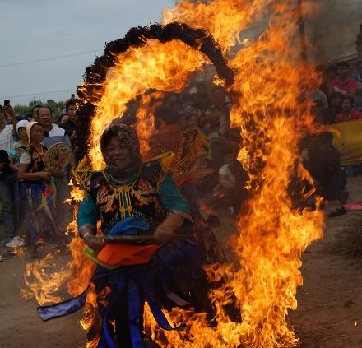
BA/Leverhulme Small Research Grants
Partner funders include:
Sino-British Fellowship Trust
EY
Society for the Advancement of Management Studies
Honor Frost Foundation
British Accounting and Finance Association
Journal of Moral Education Trust
Philosophy of Education Society of Great Britain

Slide 26

BA/Leverhulme Small Research Grants
Partial Randomised Allocation
Applications assessed through normal peer review process to determine whether pass quality threshold or not
Those passing quality threshold entered randomised allocation process
Will allow feedback to be given to applicants in this scheme – reason for not passing quality threshold, e.g. not strong enough methodology, not feasible etc or high quality application passing threshold not selected through random selection
Will monitor for effects on diversity – removes human bias element at final stage of selection
Autumn 2022 round attracted 22% more applications than previous year

Slide 27
BA/Leverhulme Small Research Grants
Average success rates over past 5 years

Slide 28

Academy Research Projects
Support primary research
Particularly collaborative projects intended to provide infrastructural resources for other researchers and public
Clear focus on long-term sustainability
£25k over 5 years (up to £5k annually) for core support
Kitemark of recognition as outstanding research project
Enables approaches to other funders to build on core funding
Currently 50 projects in portfolio such as Early English Church Music; Understanding Society; British Religion in Numbers
Last call closed December 2022 – awards announced March 2023
Funding available to offer further calls for new projects in 2023 and 2024, adding 3-6 projects
Notes:
.

Slide 29

BA Conferences
Major events of lasting academic significance
Any UK-based scholar may be PI
Supports up to 12 events at the BA, online and at other venues
Interdisciplinary, across the humanities and social sciences
Suitable for collaboration with other non-academic specialist experts
New strand of 5 British Academy/Wellcome Trust Conferences designed to foster discussion & debate on health and wellbeing related themes – introduced from 2022.
Annual call - call closed 25 January 2023, for conferences in financial year 2024-25, i.e. from 1 April 2024
Notes:
At least 5 of the 12 conferences will be BA/Wellcome Trust Conferences

Slide 30

Proceedings of the British Academy
Open to any UK-based researcher, not necessarily award-holder or FBA
Multi-author themed volumes of essays
Landmark publications seeking to drive forward research in a subject
Any subject or combination of subjects across the humanities and social sciences
Not necessarily arising from conferences
Proposing Editor has freedom to shape volume
Calls for proposals run throughout the year with next deadline being 22 February 2023

Slide 31
Public Policy Work
The Academy’s Public Policy Team are focusing their work on four themes:
Governance, Trust and Voice - Exploring how the UK can develop effective multi-level governance structures for policy and decision-making.
Social and Cultural Infrastructures – Understanding the services, structures and relationship that support quality of life within and between communities.
Sustainable Futures - Championing the role of SHAPE research in the policy responses to sustainable development.
Digital society - Exploring the ways in which digital technologies, tools and practices shape and are shaped by our society.
Within these themes, new funding opportunities are likely to become available in 2023/24.
Opportunities may include:
Calls for policy insight case studies
Calls for short discussion papers
Calls to contribute to our policy histories series
Commissioning larger policy research projects to answer specific policy questions

Slide 32
International Challenges
The British Academy funds a range of international programmes which support excellence in the UK and overseas, promote international collaboration and harness the expertise of the social sciences and humanities to tackle global challenges.
Since 2016 our programmes have supported over 496 awards with more than 185 awards ongoing on challenges related to cities and urbanisation, conflict and violence, and education and youth, as well as a programme of mentoring support for early career researchers to develop their professional networks and build their skills related to academic publishing and grant writing.
Notes:
[Read slide.]
The Academy has developed a position of expertise in shaping, influencing and advising policy internationally for the UK and at a global level and if you are interested with collaborating with us on any of these things then do let us know.
Our other programmes and activities which include funding calls, but also include international conferences, roundtables, workshops, briefings, reports, and consultation responses. This presentation will provide an overview of our current and upcoming programmes, as well as some insight into the work we have been doing on briefings and policy reports.
We will shortly be launching Knowledge Frontiers: International Interdisciplinary Research 2023. We are finalising the details for the call, and expect to be announcing this in the next few weeks. The deadline for this call will be October 2022, further information will be made available on our website.

Slide 33
British Academy International Fellowships
This scheme builds the long running Newton International Fellowships
Enhanced three-year individual career development Fellowship funded by BEIS
International researchers with no prior connection to UK academic community to come and research at UK host institution, with support by a mentor
Support early career researchers to pursue high-quality and innovative lines of research
Funding to a maximum of £400,000 over three years, at 80% fEC
Alumni funding if leave UK at end to continue collaboration
Currently open for applications, deadline is 28 March 2023

Slide 34
Global Professorships
This programme aims to demonstrate and further enhance the UK’s commitment to international research partnerships and collaboration as well a strengthen the UK’s research capacity and capability in the humanities and social sciences
Possibility of a new call later this year
Four-year individual professorship funded by BEIS
Focus on fit with UK host institution and value to wider UK research community
Provides opportunity for mid-career to senior researchers from any country overseas to undertake high-risk, curiosity driven, beyond the state-of-the-art research
Funding to a maximum of £900,000 over four years, no longer requires host institution contributions

Slide 35
Knowledge Frontiers: International Interdisciplinary Research
This scheme supports UK-based researchers working with international partners developing interdisciplinary research projects
Each call has a thematic focus, recent themes include ‘Global (Dis)Order’ and ‘What is a good city?’
Collaboration between researchers of different disciplines and at different institutions is required
Interdisciplinarity is understood differently across different calls
Funding is to a maximum of £200,000 over two years, at 80% fEC
Normally opens for applications in the Spring, with the deadline in the Autumn

Slide 36
International Writing Workshops
Project duration of 2 years and up to £30,000 in funding.
The programme aims to encourage and support early career researchers to publish in high impact journals, and enable them to develop connections with academics and journal editors based nationally and internationally.
The lead applicant must be based in the UK and be of postdoctoral or above status. Each application must have at least one Co-Applicant based in an ODA-eligible country.
The most recent call deadline was Wednesday 9 November 2022
Notes:
From our international offering, we currently have one programme open for applications at the moment – our Global Professorships programme.
The aim of this programme is to attract internationally-recognised established scholars to further their individual research goals while enhancing the UK’s commitment to international research partnerships and collaboration and is intended to strengthen the UK’s research excellence and capability in the humanities and the social sciences.
It is a 4 year award for mid-career to senior scholars active in any discipline in the social sciences and humanities and based in any country overseas. Applicants must be available to take up a position at a UK institution for the duration of the 4 year award, however the model for how an individual might do this is flexible and could be, for example, a secondment, a salaried appointment, an unpaid leave of absence, or developing a partnership between the host institution and an international institution. We do not necessarily require the successful applicants to give up their existing appointment outside the UK.
The Global Professorships are awards for individuals in an institutional setting. Applications must be for new, coherent and cutting-edge projects which are expected to add significant value to the UK host institutions and vice versa, and thus the projects must be significant, leading to novel and innovative collaborations. With the Global Professorships, the Academy is looking to support academics that are proposing ambitious, beyond the state-of-the-art applications that break new ground. The Academy views them as an opportunity to apply to undertake high-risk, curiosity-driven research in the humanities and social sciences that enables the award-holders and their UK host institutions to achieve a step-change in their respective research programmes.
In a change to previous rounds, the Academy will not be requesting a host institution contribution. The total funding available from the Academy over the four years of the award is up to £900,000 with the host institution not required to provide any additional resource.
We welcome applications from a diverse range of UK host institutions and wish to particularly encourage applications from historically and/or structurally disadvantaged groups and low-income countries. The Academy realises that an application for a Global Professorship is a major professional, personal and family commitment. Our staff are available to discuss with potential applicants how arrangements could be made to facilitate applicants undertaking such a significant commitment.
The deadline for applications for this round is Wednesday 27 April at 5pm

Slide 37
Researchers at Risk
A new fellowship programme established by the BA with the support also of the Academy of Medical Sciences, the Royal Academy of Engineering, the Royal Society and Cara (the Council of At-Risk Academics) in response to the Russian invasion of Ukraine.
The Fellowships are available to researchers at postdoctoral level and above, and cover physical and biological sciences, medical and health sciences, engineering, humanities, social sciences and the arts with applications made via UK-based institutions.
The programme provides fellowships of up to two years to Ukraine-based researchers at risk with funding of up to £37,000 per annum.
At its outset the programme received £3 million of UK Government funding from BEIS. The Nuffield Foundation also contributed £0.5 million towards the scheme. The programme received further UK government funding of £9.8 million from BEIS and the FCDO. SAGE Publishing Ltd has contributed £50,000 also towards the scheme.
Next deadline is 8 February
Notes:
From our international offering, we currently have one programme open for applications at the moment – our Global Professorships programme.
The aim of this programme is to attract internationally-recognised established scholars to further their individual research goals while enhancing the UK’s commitment to international research partnerships and collaboration and is intended to strengthen the UK’s research excellence and capability in the humanities and the social sciences.
It is a 4 year award for mid-career to senior scholars active in any discipline in the social sciences and humanities and based in any country overseas. Applicants must be available to take up a position at a UK institution for the duration of the 4 year award, however the model for how an individual might do this is flexible and could be, for example, a secondment, a salaried appointment, an unpaid leave of absence, or developing a partnership between the host institution and an international institution. We do not necessarily require the successful applicants to give up their existing appointment outside the UK.
The Global Professorships are awards for individuals in an institutional setting. Applications must be for new, coherent and cutting-edge projects which are expected to add significant value to the UK host institutions and vice versa, and thus the projects must be significant, leading to novel and innovative collaborations. With the Global Professorships, the Academy is looking to support academics that are proposing ambitious, beyond the state-of-the-art applications that break new ground. The Academy views them as an opportunity to apply to undertake high-risk, curiosity-driven research in the humanities and social sciences that enables the award-holders and their UK host institutions to achieve a step-change in their respective research programmes.
In a change to previous rounds, the Academy will not be requesting a host institution contribution. The total funding available from the Academy over the four years of the award is up to £900,000 with the host institution not required to provide any additional resource.
We welcome applications from a diverse range of UK host institutions and wish to particularly encourage applications from historically and/or structurally disadvantaged groups and low-income countries. The Academy realises that an application for a Global Professorship is a major professional, personal and family commitment. Our staff are available to discuss with potential applicants how arrangements could be made to facilitate applicants undertaking such a significant commitment.
The deadline for applications for this round is Wednesday 27 April at 5pm

Slide 38
Equality, Diversity, Inclusion
The British Academy is committed to equality, diversity and inclusion in everything we do, including research funding and support for our disciplines
Diversity in all aspects including gender, ethnicity, ability/disability, age, career stage, discipline, geographical and institutional
Introduction of new Additional Needs Funding opportunity for award-holders and potential applicants
Participation with UKRI in the new EDI Caucus
Continuing to monitor diversity characteristics and to encourage the widest possible pool of applicants to feel they ‘belong’ in their engagement with the Academy
Developing further recommendations for long term and sustainable change as well as more immediate actions
All of our submissions are reviewed on an individual basis and there is space in each application to note any personal circumstances that may affect your submission.

Slide 39

Evaluation criteria
For all awards, the Academy above all looks for:
research achievement
originality
relationship to work already done in the field
track record of applicant (appropriate to the aim of the scheme)
feasibility of timescale and methodology
specificity and appropriateness of intended outcomes

Slide 40
Peer review
Continued monitoring to ensure minimal bureaucracy
Application form questions designed to give assessors relevant & necessary information
Assessment processes proportionate to scale of funding requested
Relatively light-touch for Small Research Grants with quick turnaround
Longer process with more assessment stages for Postdoctoral Fellowships as a career defining opportunity with much larger scale funding

Slide 41
Peer review
Internal eligibility check by BA staff
Eligible applications assigned to relevant subject specialists – usually but not exclusively FBAs
Scores assigned and then comparative judgements made on the basis of scores
Shortlisted applicants submitted to final awarding Committee
Assessment criteria always specified in scheme guidance notes
Code of Practice governs all assessment processes including conflict of interest

Slide 42

Top tips
Think carefully about the audience reading your application
Write accessibly, with enthusiasm, offering a clear explanation of why your proposed research is important, original and worthwhile
Avoid repetition when answering the questions in the application form
Be concise – there is no need to use up any word limits
Avoid jargon
Be realistic on proposed outcomes, publication plans and dissemination

Slide 43
Top tips
Allocate time to fully prepare the application in advance of the deadline and notify your referee too​
Become familiar with the Flexi-Grant online grants management system
​
Prepare your application in word outside the Flexi-Grant system to reduce risk of loss of data due to internet problems​
Thoroughly read the scheme guidance notes and frequently asked questions​
Share your application with colleagues and your Research Office ​
Contact the BA's Research Funding team for help and support in advance of the submission deadline

Slide 44

Contacts
grants@thebritishacademy.ac.uk
flexigrant@thebritishacademy.ac.uk
posts@thebritishacademy.ac.uk
overseas@thebritishacademy.ac.uk
internationalgrants@thebritishacademy.ac.uk

