Slide 1
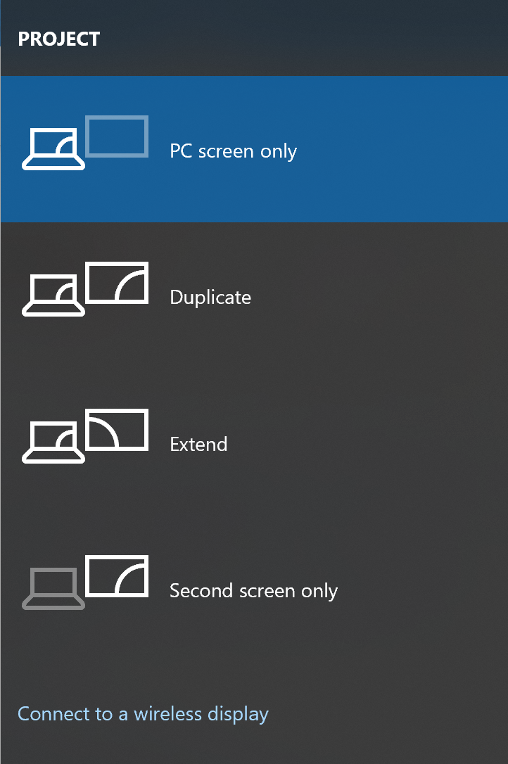
How to control multiple screen displays (Windows + P)
What do you want to do?
I want to see my laptop screen. I do not need to share it.
I want the second screen to duplicate what is on my laptop screen. This is standard presentation mode.
I have multiple screens (e.g. laptop and two monitors) and I want to use them like one large screen.
I want to use a different screen, such as a monitor, instead of my laptop screen. I don’t need my laptop screen on.
There is a screen I can connect to using Wi-Fi/Bluetooth
Need more help? Contact DTS: https://www.reading.ac.uk/digital-technology-services/it-help-and-support/contact-dts

